Slide 1

Real-time, Scalable & Robust Credit Card Fraud Detection System
This presentation outlines a comprehensive project designed to develop and implement a robust, real-time credit card fraud detection system. Leveraging advanced machine learning techniques, the system aims to safeguard financial institutions and their customers from the growing threat of credit card fraud.
SB
by Shravan Birajdar
Credit Card Fraud Detection Analysis

Slide 2
Problem Statement
The Challenge
Our Solution
Credit card fraud is a pervasive problem in the digital age, with fraudulent activities escalating alongside the growth of e-commerce and digital payments. This not only impacts individuals but also poses significant risks to financial institutions and the global economy.
This project aims to build a machine learning model that accurately identifies fraudulent transactions, empowering financial institutions to protect their customers and minimize financial losses.
Credit Card Fraud Detection Analysis

Slide 3

Data and Methodology
1
1. Data Acquisition
2
2. Data Preprocessing
We will utilize a credit card fraud dataset sourced from Kaggle, containing comprehensive transaction data, including numerical features, transaction time, amount, and fraud labels.
The dataset will be rigorously preprocessed to handle missing values, outliers, and address class imbalance, ensuring data quality and model robustness.
3
3. Feature Engineering
4
4. Model Selection and Training
Feature engineering techniques will be employed to extract relevant information from the raw data and enhance model performance, creating new features or transforming existing ones.
A range of classification algorithms will be implemented, including Logistic Regression, Support Vector Machines, Random Forest, Decision Trees, and K-Nearest Neighbors, to identify the most effective model for fraud detection.
Credit Card Fraud Detection Analysis

Slide 4




Model Evaluation and Insights
Accuracy
Insights
The model's accuracy will be assessed using metrics such as precision, recall, F1-score, and ROC-AUC curve.
The project aims to provide valuable insights into fraud patterns and trends, informing the development of proactive fraud prevention strategies.
Performance
We will select the model that demonstrates the best overall performance based on the evaluation metrics, ensuring optimal fraud detection capabilities.
Credit Card Fraud Detection Analysis

Slide 5
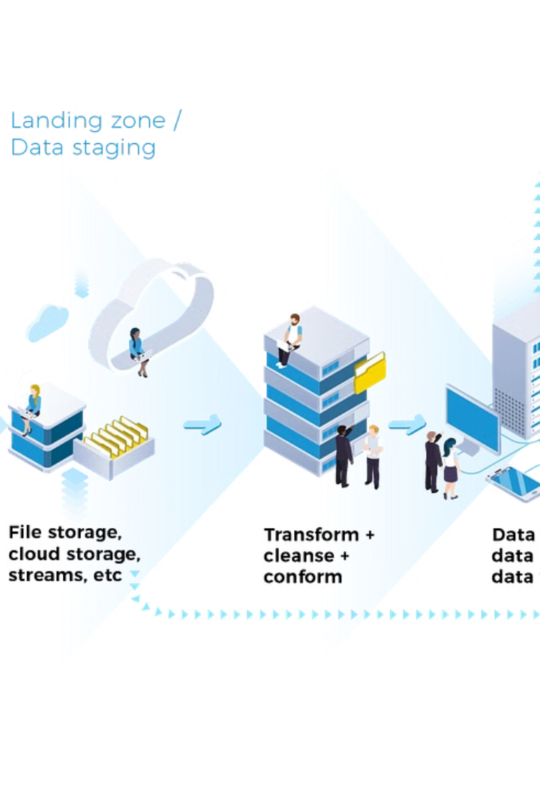
Technical Architecture
1
Data Ingestion
Real-time credit card transaction data will be continuously ingested into the system.
2
Data Preprocessing
The incoming data will undergo real-time preprocessing, including feature extraction, transformation, and outlier handling.
3
Fraud Detection
The preprocessed data will be fed into the trained machine learning model for fraud detection, generating predictions in real-time.
4
Alerting and Response
Suspected fraudulent transactions will trigger alerts, enabling financial institutions to take immediate action, such as blocking transactions or initiating investigations.
Credit Card Fraud Detection Analysis

Slide 6




Risk Mitigation
Data Quality
Ensuring high data quality is paramount for accurate model performance. We will implement data validation and cleansing techniques to minimize errors.
Imbalanced Data
Addressing the inherent class imbalance in fraud datasets is crucial to avoid biased models. We will employ techniques like oversampling or undersampling to mitigate this challenge.
Evolving Fraud Tactics
Fraudsters constantly adapt their techniques. We will implement a continuous monitoring system to detect emerging fraud patterns and adapt the model accordingly.
Credit Card Fraud Detection Analysis

Slide 7



Expected Outcomes
1
Reduced Losses
2
Enhanced Trust
3
Accurate Detection
The project aims to deliver significant benefits to financial institutions and their customers, including a highly accurate fraud detection model, reduced financial losses, enhanced customer trust, and valuable insights into fraud patterns and trends.
Credit Card Fraud Detection Analysis

Slide 8

Conclusion
1
2
Proactive Security
Customer Protection
This project aims to significantly contribute to the field of financial security by empowering financial institutions to proactively detect and prevent credit card fraud.
The successful implementation of a robust fraud detection system will safeguard customers from unauthorized transactions, enhancing their confidence in digital payments.
Credit Card Fraud Detection Analysis

Slide 9
Thank You…!
SB
by Shravan Birajdar
Credit Card Fraud Detection Analysis

